Slide 1
COMP 2230
Week 11 - Monday

Slide 2
Last time
Trees
Rooted trees
Spanning trees

Slide 3
Questions?

Slide 4
Assignment 5

Slide 5
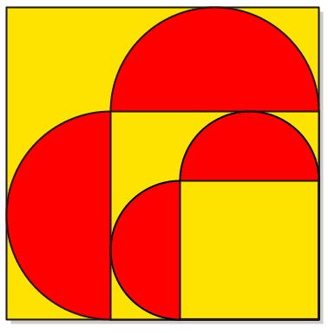
Logical warmup
Which has a bigger total area?
  Yellow
  Red

Slide 6
Spanning Trees

Slide 7
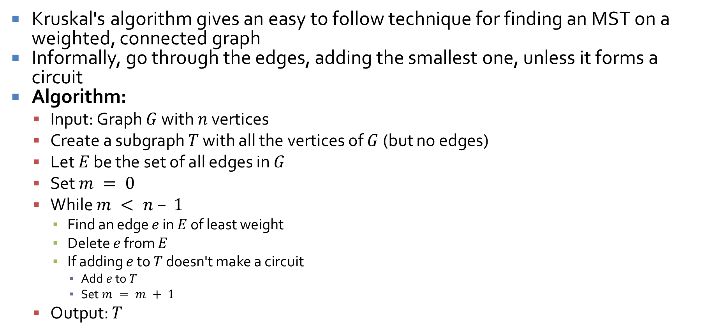
Finding a minimum spanning tree
Kruskal's algorithm gives an easy to follow technique for finding an MST on a weighted, connected graph
Informally, go through the edges, adding the smallest one, unless it forms a circuit
Algorithm:
  Input: Graph $G$ with $n$ vertices
  Create a subgraph $T$ with all the vertices of $G$ (but no edges)
  Let $E$ be the set of all edges in $G$
  Set $m = 0$
  While $m < n – 1$
    Find an edge $e$ in $E$ of least weight
    Delete $e$ from $E$
    If adding $e$ to $T$ doesn't make a circuit
      Add $e$ to $T$
      Set $m = m + 1$
  Output: $T$

Slide 8
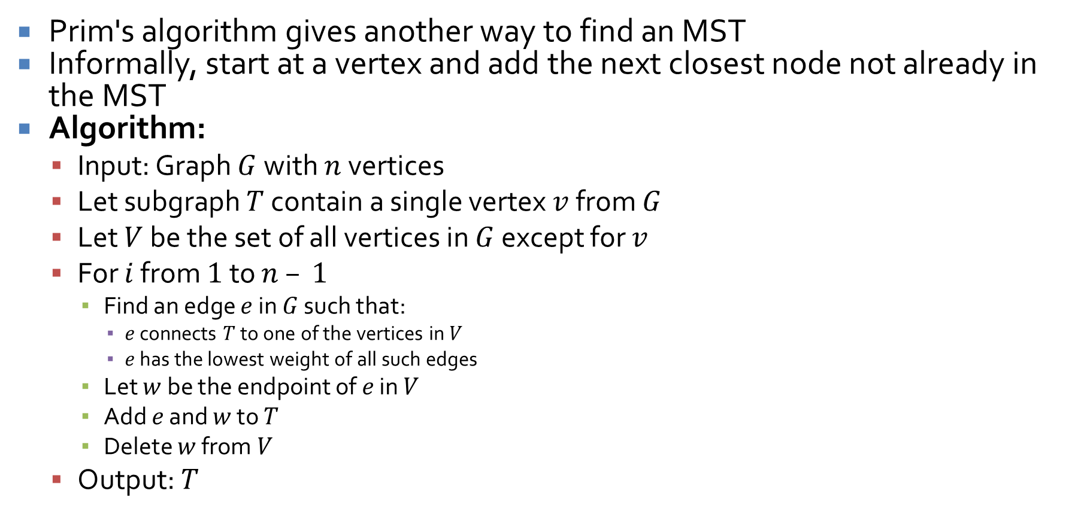
Prim's algorithm
Prim's algorithm gives another way to find an MST
Informally, start at a vertex and add the next closest node not already in the MST
Algorithm:
  Input: Graph $G$ with $n$ vertices
  Let subgraph $T$ contain a single vertex $v$ from $G$
  Let $V$ be the set of all vertices in $G$ except for $v$
  For $i$ from $1$ to $n – 1$
    Find an edge $e$ in $G$ such that:
      $e$ connects $T$ to one of the vertices in $V$
      $e$ has the lowest weight of all such edges
    Let $w$ be the endpoint of $e$ in $V$
    Add $e$ and $w$ to $T$
    Delete $w$ from $V$
  Output: $T$

Slide 9






Prim fights Kruskal
Apply Kruskal's algorithm to the graph below
Now, apply Prim's algorithm to the graph below
Is there any other MST we could make?
$$2$$
$$3$$
$$1$$
$$4$$
$$1$$
$$3$$
$$1$$

Slide 10
Graphing Functions and Big-O, Big-Omega, and Big-Theta Notations
Three-Sentence Summary

Slide 11
Graphing Functions

Slide 12
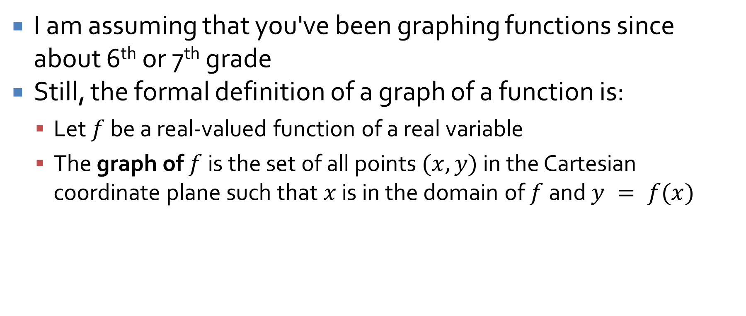
Graphing functions
I am assuming that you've been graphing functions since about 6th or 7th grade
Still, the formal definition of a graph of a function is:
  Let $f$ be a real-valued function of a real variable
  The graph of $f$ is the set of all points $(x, y)$ in the Cartesian coordinate plane such that $x$ is in the domain of $f$ and $y = f(x)$

Slide 13
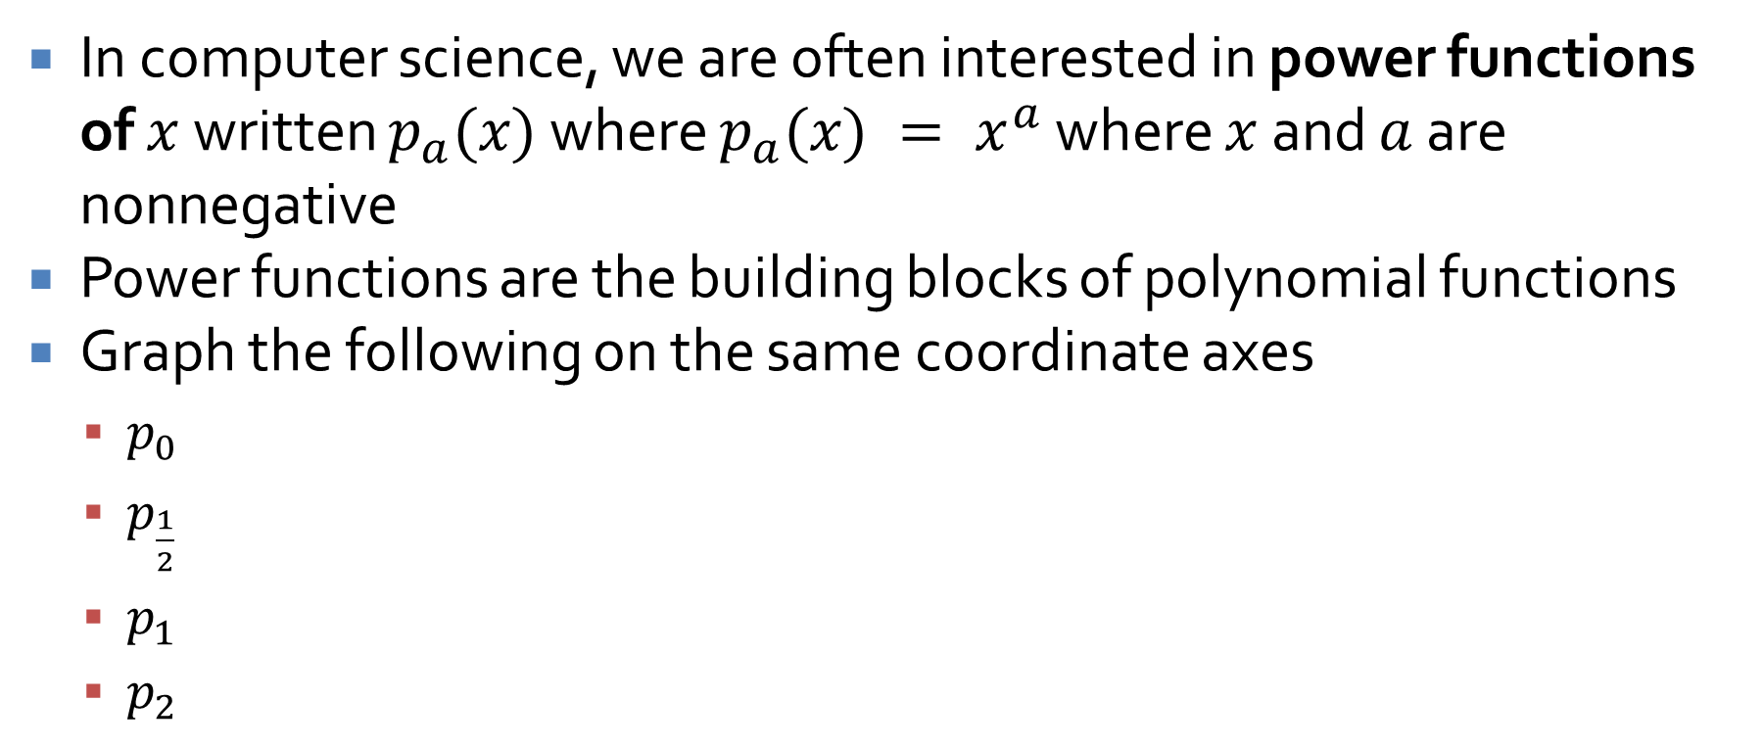
Power functions
In computer science, we are often interested in power functions of $x$ written $p_{a}(x)$ where $p_{a}(x) = x^{a}$ where $x$ and $a$ are nonnegative
Power functions are the building blocks of polynomial functions
Graph the following on the same coordinate axes
  $p_{0}$
  $p_{\frac{1}{2}}$
  $p_{1}$
  $p_{2}$

Slide 14
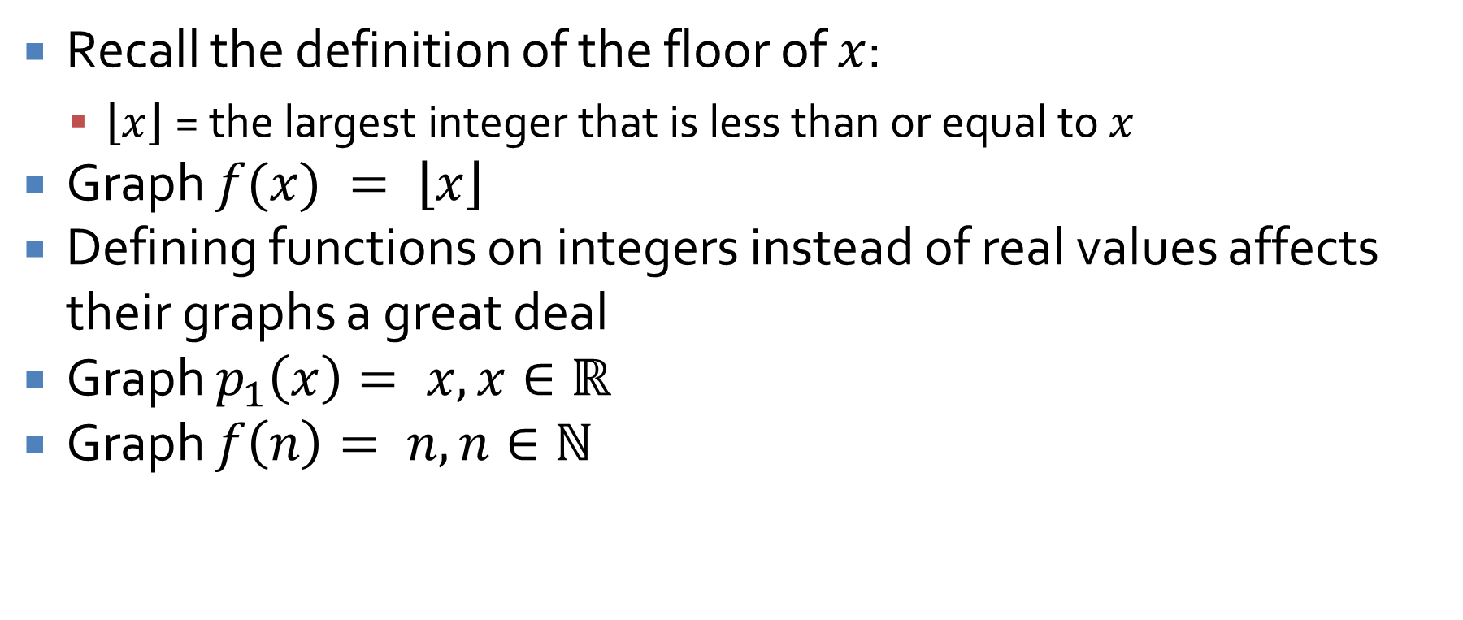
Discontinuous functions
Recall the definition of the floor of $x$:
  $\left\lfloor x\right\rfloor$= the largest integer that is less than or equal to $x$
Graph $f(x) = \left\lfloor x\right\rfloor$
Defining functions on integers instead of real values affects their graphs a great deal
Graph $p_{1}\left(x\right)= x, x∈ℝ$
Graph $f\left(n\right)= n, n∈ℕ$

Slide 15
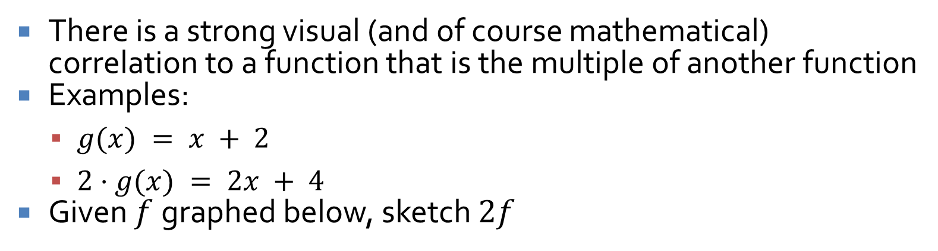
Multiples of functions
There is a strong visual (and of course mathematical) correlation to a function that is the multiple of another function
Examples:
  $g(x) = x + 2$
  $2⋅g(x) = 2x + 4$
Given $f$ graphed below, sketch $2f$
2
1
-6 -5 -4 -3 -2 -1
-1
-2
1 2 3 4 5 6

Slide 16
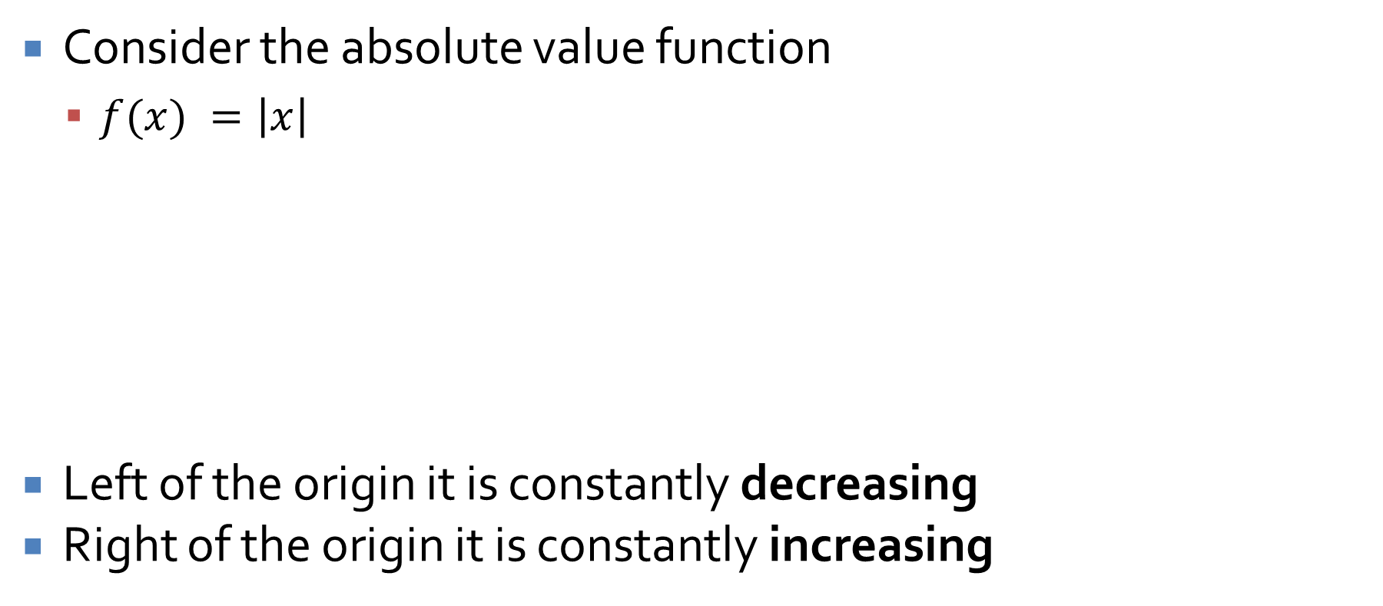
Absolute value
Consider the absolute value function
  $f(x) =\left|x\right|$
Left of the origin it is constantly decreasing
Right of the origin it is constantly increasing
2
1
-6 -5 -4 -3 -2 -1
-1
-2
1 2 3 4 5 6

Slide 17
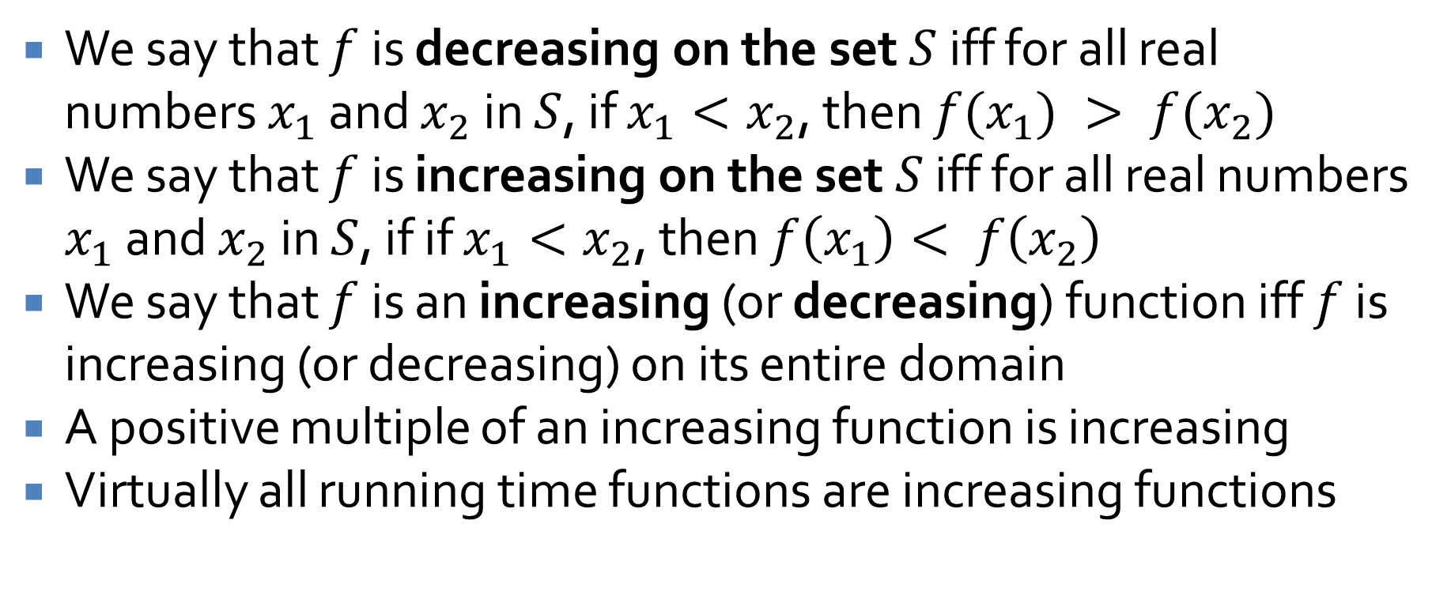
Increasing and decreasing functions
We say that $f$ is decreasing on the set $S$ iff for all real numbers $x_{1}$ and $x_{2}$ in $S$, if $x_{1}<x_{2}$, then $f(x_{1}) > f(x_{2})$
We say that $f$ is increasing on the set $S$ iff for all real numbers $x_{1}$ and $x_{2}$ in $S$, if if $x_{1}<x_{2}$, then $f\left(x_{1}\right)< f\left(x_{2}\right)$
We say that $f$ is an increasing (or decreasing) function iff $f$ is increasing (or decreasing) on its entire domain
A positive multiple of an increasing function is increasing
Virtually all running time functions are increasing functions

Slide 18
Asymptotic Notations

Slide 19
Growth of functions
Mathematicians worry about the growth of various functions
They usually express such things in terms of limits, maybe with derivatives
We are focused primarily on functions that bound running time spent and memory consumed
We just need a rough guide
We want to know the order of the growth

Slide 20
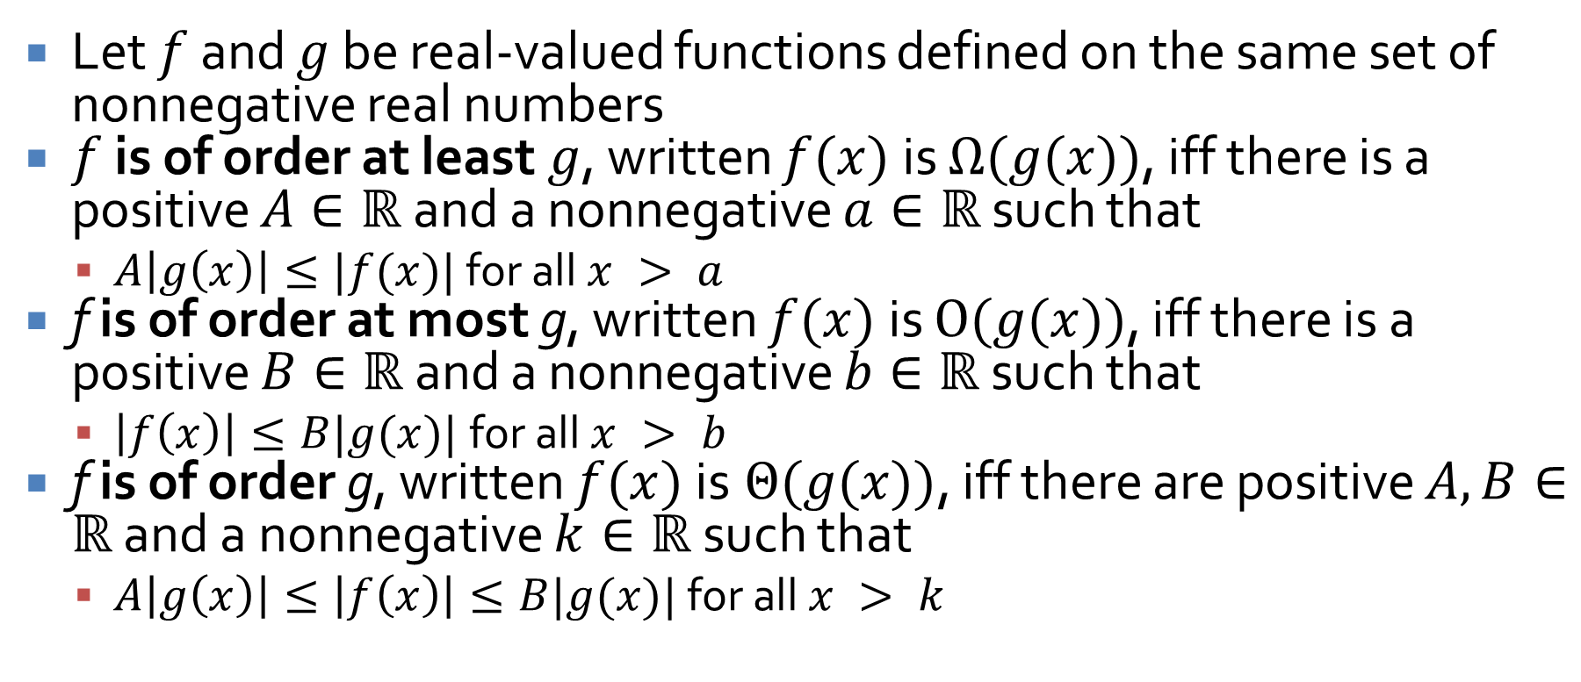
Definitions
Let $f$ and $g$ be real-valued functions defined on the same set of nonnegative real numbers
$f$ is of order at least $g$, written $f(x)$ is $Ω(g(x))$, iff there is a positive $A∈ℝ$and a nonnegative $a∈ℝ$ such that
  $A\left|g\left(x\right)\right|≤|f(x)|$ for all $x > a$
f is of order at most g, written $f(x)$ is $O(g(x))$, iff there is a positive $B∈ℝ$ and a nonnegative $b∈ℝ$ such that
  $\left|f\left(x\right)\right|≤B|g(x)|$for all $x > b$
f is of order g, written $f(x)$ is $Θ(g(x))$, iff there are positive $A, B∈ℝ$ and a nonnegative $k∈ℝ$ such that
  $A\left|g\left(x\right)\right|≤\left|f\left(x\right)\right|≤B|g(x)|$ for all $x > k$

Slide 21
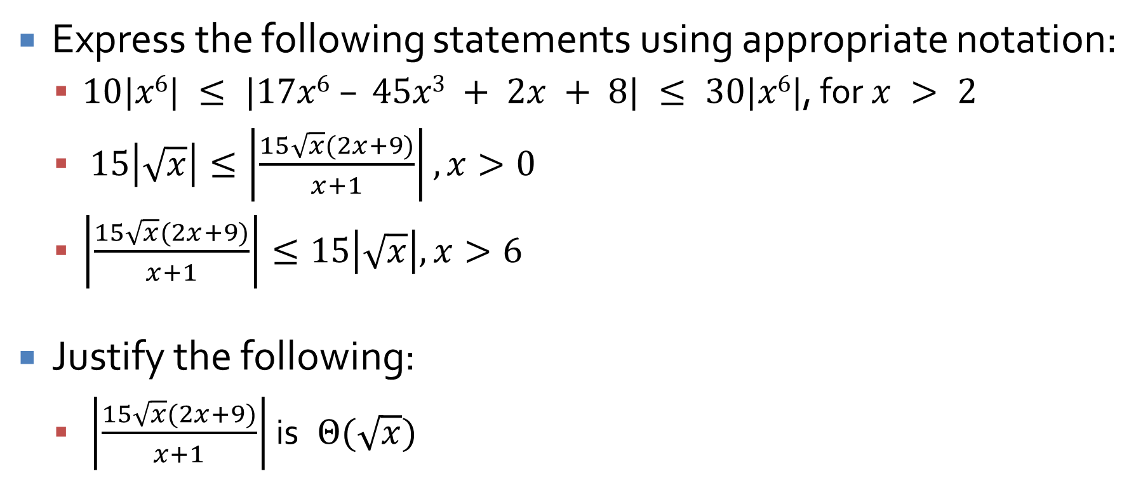
Using the notation
Express the following statements using appropriate notation:
  $10|x6| ≤ |17x6 – 45x3 + 2x + 8| ≤ 30|x6|$, for $x > 2$
  $15\left|\sqrt{x}\right|≤\left|\frac{15\sqrt{x}(2x+9)}{x+1}\right|,x>0$
  $\left|\frac{15\sqrt{x}(2x+9)}{x+1}\right|≤15\left|\sqrt{x}\right|,x>6$
Justify the following:
  $\left|\frac{15\sqrt{x}(2x+9)}{x+1}\right|$ is $Θ(\sqrt{x})$

Slide 22
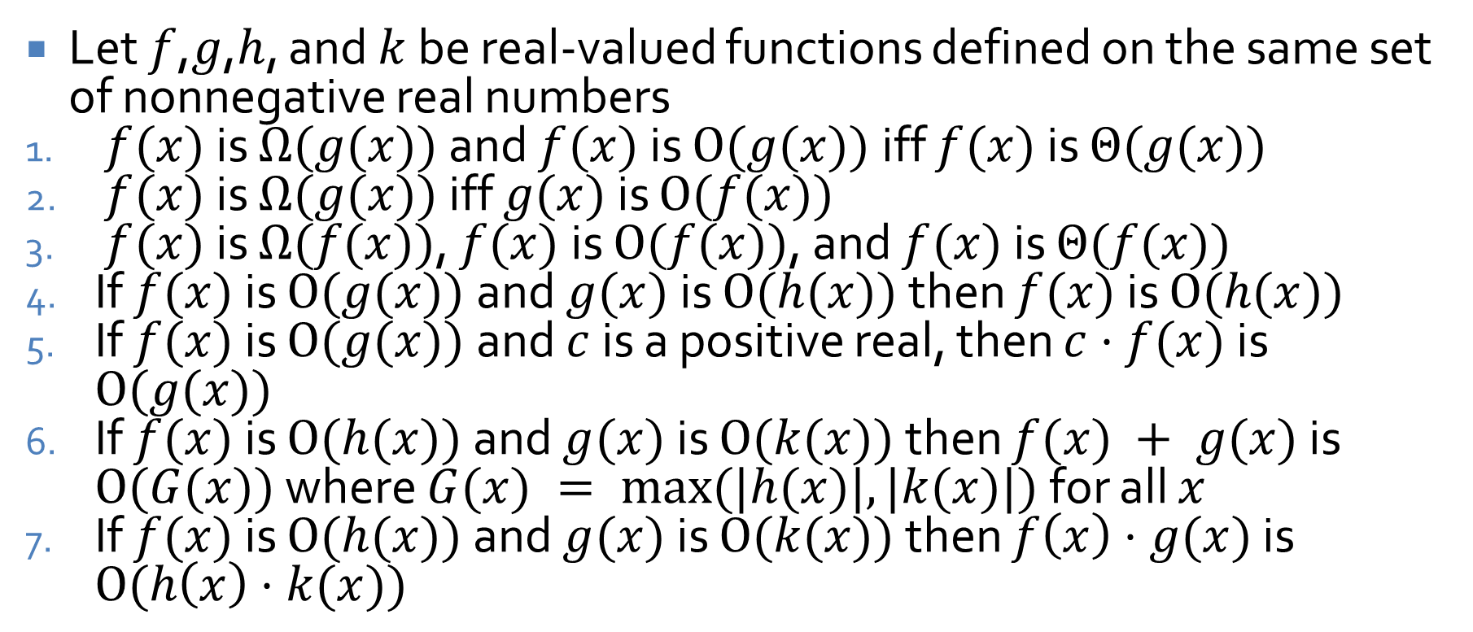
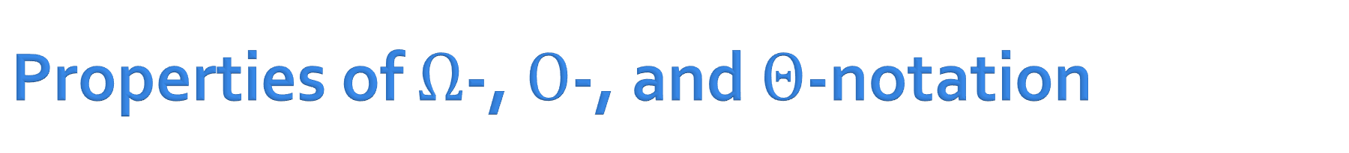
Properties of $Ω$-, $O$-, and $Θ$-notation
Let $f$,$g$,$h$, and $k$ be real-valued functions defined on the same set of nonnegative real numbers
$f(x)$ is $Ω(g(x))$ and $f(x)$ is $O(g(x))$ iff $f(x)$ is $Θ(g(x))$
$f(x)$ is $Ω(g(x))$ iff $g(x)$ is $O(f(x))$
$f(x)$ is $Ω(f(x))$, $f(x)$ is $O(f(x))$, and $f(x)$ is $Θ(f(x))$
If $f(x)$ is $O(g(x))$ and $g(x)$ is $O(h(x))$ then $f(x)$ is $O(h(x))$
If $f(x)$ is $O(g(x))$ and $c$ is a positive real, then $c⋅f(x)$ is $O(g(x))$
If $f(x)$ is $O(h(x))$ and $g(x)$ is $O(k(x))$ then $f(x) + g(x)$ is $O(G(x))$ where $G(x) = max⁡(|h(x)|,|k(x)|)$ for all $x$
If $f(x)$ is $O(h(x))$ and $g(x)$ is $O(k(x))$ then $f\left(x\right)⋅g(x)$ is $O(h\left(x\right)⋅k(x))$

Slide 23
Ticket Out the Door

Slide 24
Upcoming

Slide 25
Next time…
Analysis of algorithm efficiency I
Exponential and logarithmic functions

Slide 26
Reminders
Work on Assignment 5
Read 11.3 and 11.4
  Prepare a three-sentence summary
  Extra credit if you get called on

